Slide 1

Predict Value of Top
Six Leagues Clubs
Amjad Alobaily | 26 Sep 2021

Slide 2
01
Problem Description
02
Datasets
Agenda
03
Models Results
04
Assumptions
05
Conclusion

Slide 3
Problem
Description
01

Slide 4

The total numbers of the world is around 11000, and the total value of all clubs in The world around 40 billion dollars, and the Revenue from the clubs around 6 billion dollars Each year
So how can we predict the value for each club ?
01
Problem Description

Slide 5
02
Datasets

Slide 6

Datasets
02

Slide 7







Datasets
02

Slide 8
Total websites
Total Features
Total Data
121 Sites
13 Features
1483 data
Datasets
02

Slide 9









Club
Name
Total
Squad
Foreign
Player
Stadium
Capacity
Average
Age
League
Value
Since in
League
National
Player
League
Name
Club
Value
Datasets
02

Slide 10
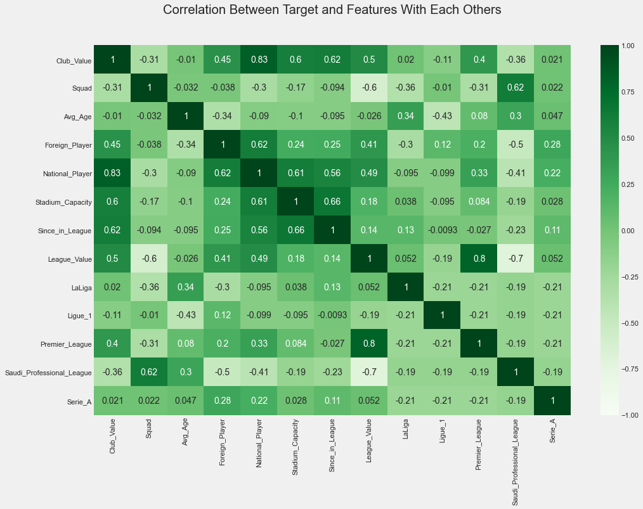
Datasets
02

Slide 11
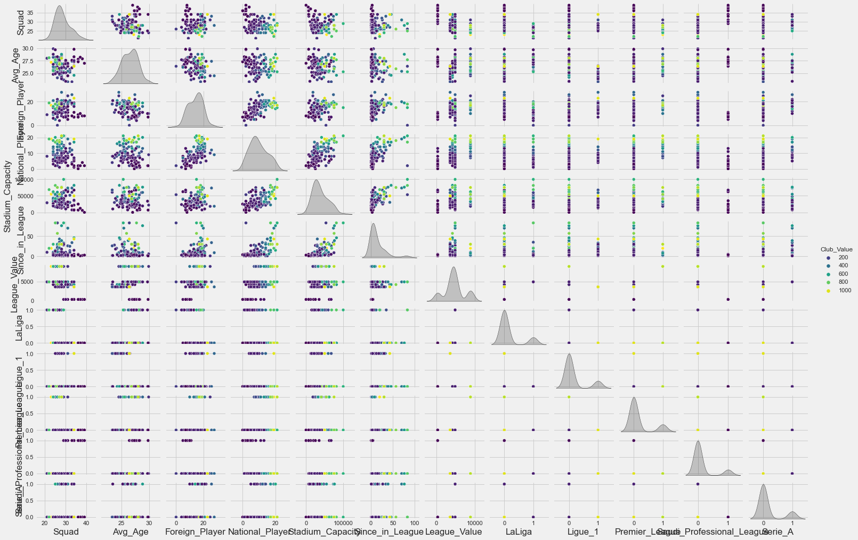
Pair plot
Datasets
02

Slide 12
03
Models
Results

Slide 13
03
Models Results
Ridge
Regression
0.76
0.74
Liner
Regression
Lasso
Regression
0.72
0.69
Polynomial
Regression

Slide 14
03
Models Results
Ridge
Regression
0.76
0.74
Liner
Regression
Lasso
Regression
0.72
0.69
Polynomial
Regression

Slide 15
01
Liner Regression
Club
Name
Total
Squad
Foreign
Player
Stadium
Capacity
Average
Age
League
Value
Since in
League
National
Player
League
Name
Club
Value

Slide 16
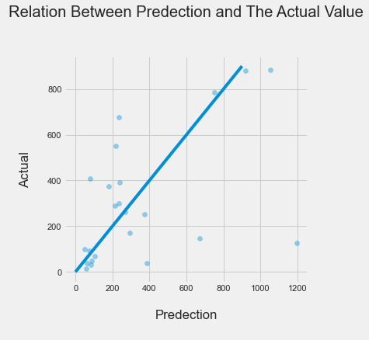
01
Liner Regression

Slide 17
03
Models Results
Ridge
Regression
0.76
0.74
Liner
Regression
Lasso
Regression
0.72
0.69
Polynomial
Regression

Slide 18
03
Models Results
Ridge
Regression
0.76
0.74
Liner
Regression
Lasso
Regression
0.72
0.69
Polynomial
Regression

Slide 19
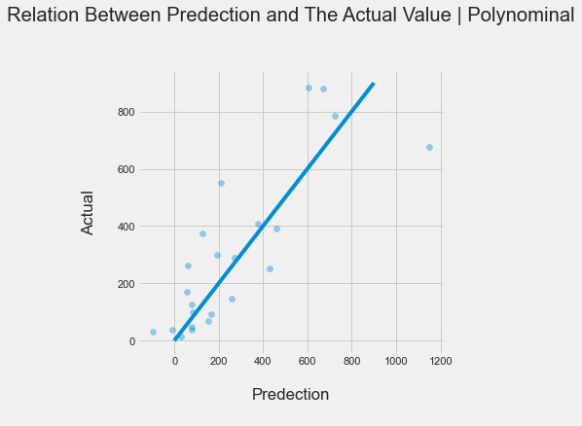
02
Polynomial Regression

Slide 20
03
Models Results
Ridge
Regression
0.76
0.74
Liner
Regression
Lasso
Regression
0.72
0.69
Polynomial
Regression

Slide 21
03
Models Results
Ridge
Regression
0.76
0.74
Liner
Regression
Lasso
Regression
0.72
0.69
Polynomial
Regression

Slide 22
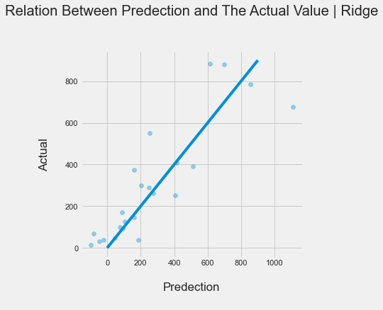
03
Ridge Regression

Slide 23
03
Models Results
Ridge
Regression
0.76
0.74
Liner
Regression
Lasso
Regression
0.72
0.69
Polynomial
Regression

Slide 24
03
Models Results
Ridge
Regression
0.76
0.74
Liner
Regression
Lasso
Regression
0.72
0.69
Polynomial
Regression

Slide 25
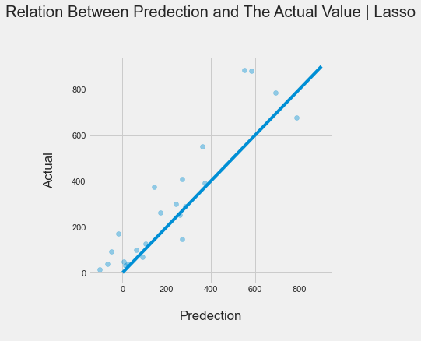
04
Lasso Regression

Slide 26
03
Models Results
Ridge
Regression
0.76
0.74
Liner
Regression
Lasso
Regression
0.72
0.69
Polynomial
Regression

Slide 27
04
Assumptions

Slide 28
02
01
03
05
04

Slide 29
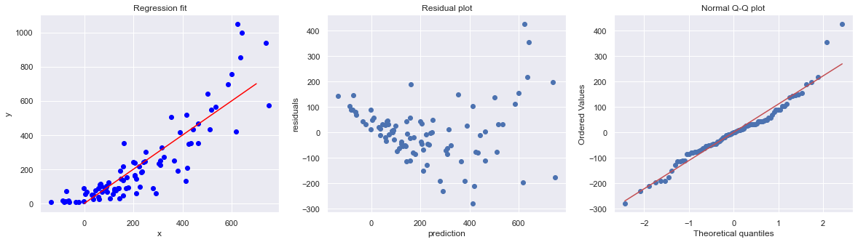
01
Assumption | Regression is Linear in Parameters

Slide 30
02
01
03
05
04

Slide 31
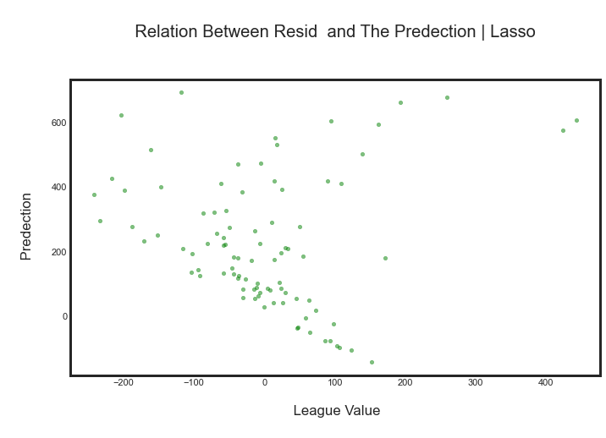
02
Assumption | Residuals should be normally distributed with zero mean

Slide 32
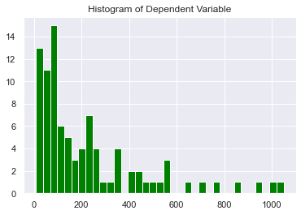
02
Assumption | Residuals should be normally distributed with zero mean

Slide 33
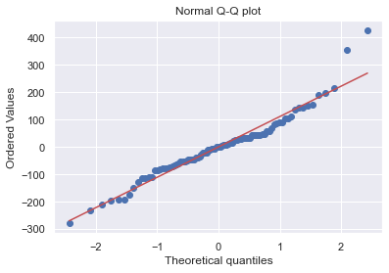
02
Assumption | Residuals should be normally distributed with zero mean

Slide 34
02
01
03
05
04

Slide 35
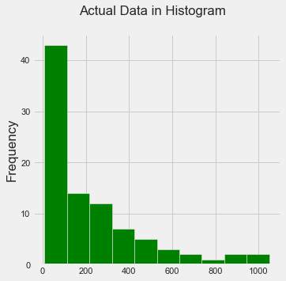
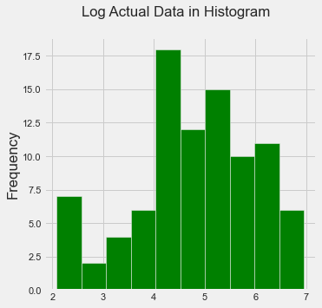
03
Assumption | Error terms must have constant variance

Slide 36
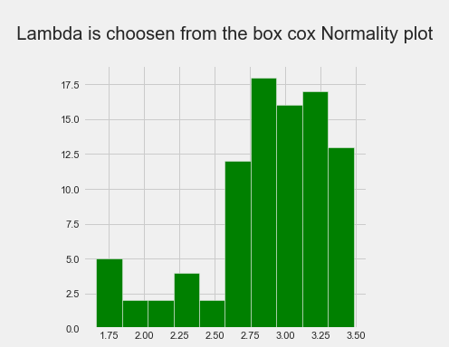
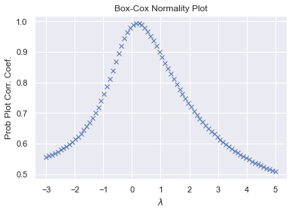
03
Assumption | Error terms must have constant variance

Slide 37
02
01
03
05
04

Slide 38
04
Assumption | Errors are uncorrelated across observations
Not Applicable

Slide 39
02
01
03
05
04

Slide 40
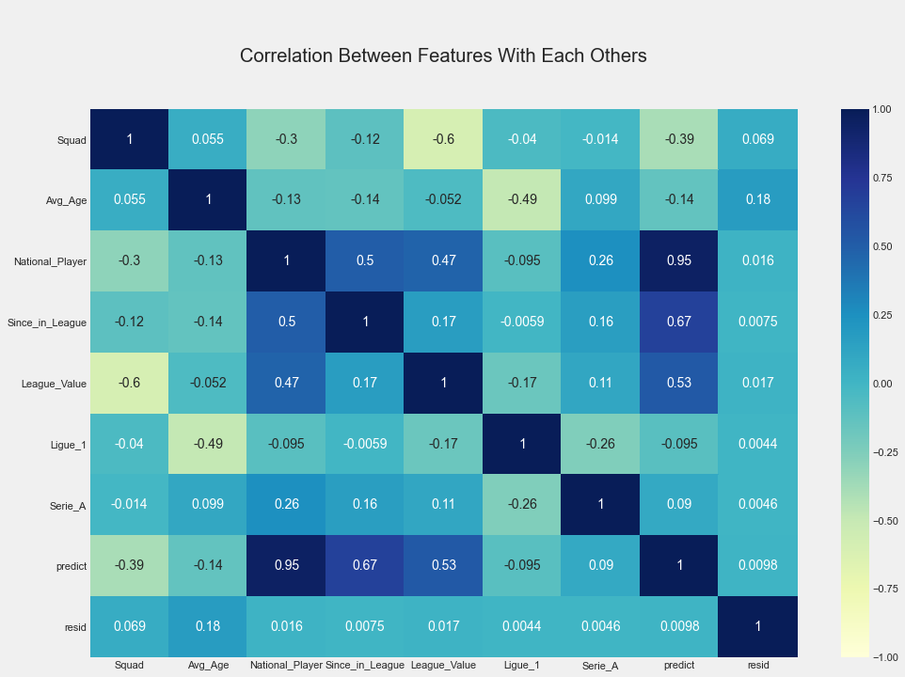
05
Assumption | No independent variable is a perfect linear

Slide 41
02
01
03
05
04

Slide 42

After we build the four models
We found that :
The Liner Regression is the best one to predict the club value in accuracy around 75%
The data not enough to be more accurate.
While the league itself have high value the club will effect.
Conclusion
06

